Slide 1
QUANTitative
Quantitative→Quantity
Uses numbers and measurements to describe data

Slide 2
QUALitative
Qualitative→Quality
Uses the 5 senses to describe how something looks, smells, tastes, etc.

Slide 3
The Scientific Method
A problem-solving technique!

Slide 4
Scientific Method Steps! ☺
State the Problem
Gather Information
Form a Hypothesis
Perform the Experiment
Collect & Analyze Data
Draw Conclusions
S.G.F.P.C.D. Sam Gave Fred Pink Circle Drawings

Slide 5
Agenda
Warm Up & Homework Check
Scientific Method Review
Density Review
Air Pressure Notes
Layers of the Atmosphere Notes
Data Tracking & Project Intro☺

Slide 6
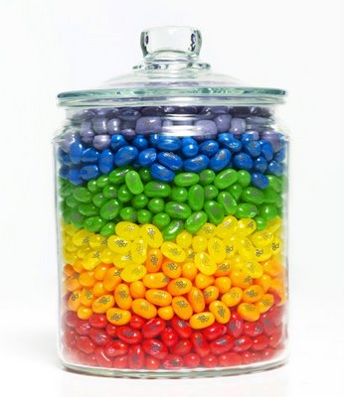
What is Density?
mass
The amount of _________in a given volume of a substance.
How tightly packed molecules are.
If something has tightly packed molecules then it is ____________________.
If something has loose packed molecules then it is __________________.
VERY dense
less dense
Notes:
This is because of density.

Slide 7
Agenda
Warm Up & Homework Check
Scientific Method Review
Density Review
Air Pressure Notes
Layers of the Atmosphere Notes
Data Tracking & Project Intro☺

Slide 8
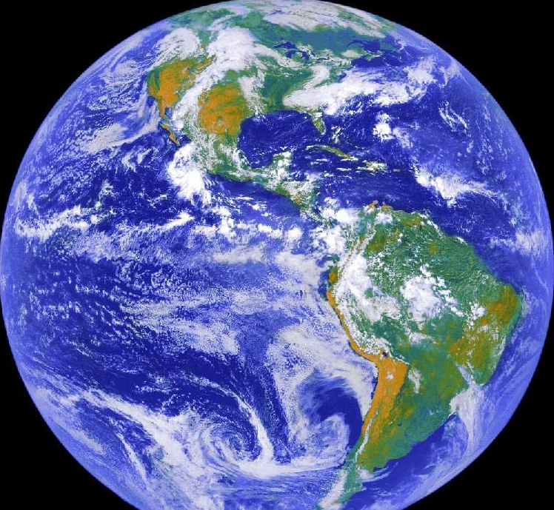
AIR
The rules of density also apply to the air in our atmosphere!!

Slide 9
Air surrounds our Earth.
Air is made up of different kinds of gases.
These gases take the form of molecules!
These molecules are constantly moving and are affected by gravity!

Slide 10
Air Molecules
Oxygen = air molecule
Nitrogen = air molecule
Other Gasses= air molecule
Which is the most common??
NITROGEN!!!!

Slide 11
What is Air Pressure?
Air pressure is the weight of the Earth’s atmosphere pressing down on everything at the surface.

Slide 12
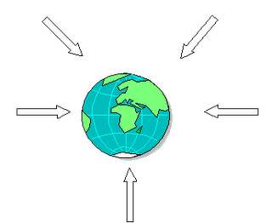
What does gravity have to do with it?
Gravity is pulling these air molecules (nitrogen, oxygen, other) closer to the center of the Earth.
Notes:
Gravity is pulling these air molecules closer to the center of the Earth.

Slide 13
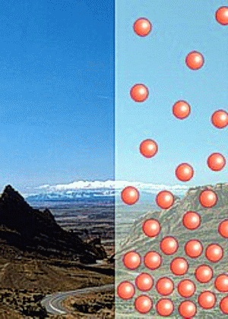
Air at the Top of a Mountain!
Altitude is the height of an object.
Top of a mountain= high altitude

Slide 14
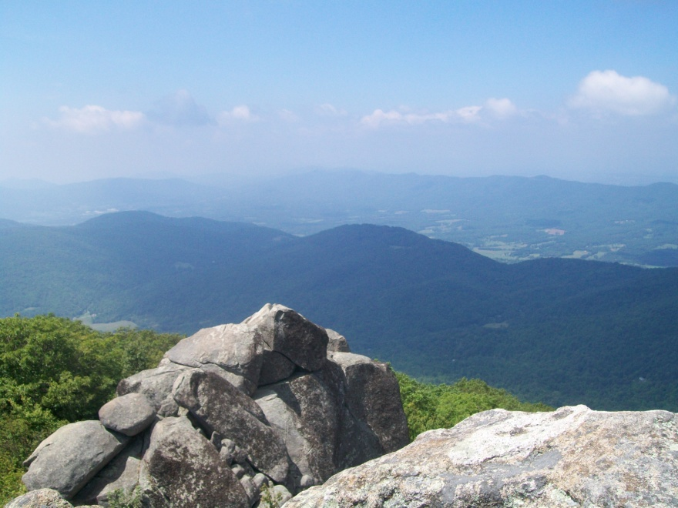
Think-Pair-Share
Take 30 seconds to imagine you are on the top of a mountain.
Answer the following questions:
Is the air more or less dense than at the bottom of the mountain?

Slide 15
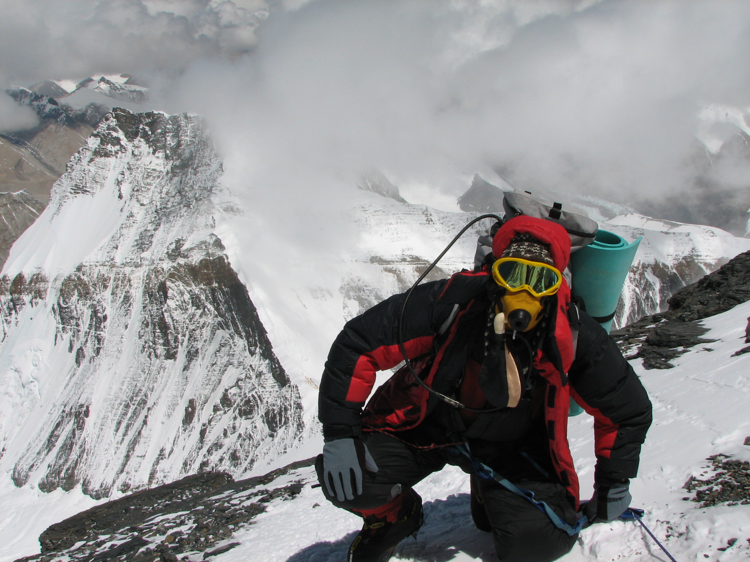
Let’s Watch: Elevation Trianing Mask!
https://www.youtube.com/watch?v=mGQ-vyVwLmM

Slide 16
Air is less dense at the top of the mountain!!
The air dense and there is LESS air pressure at the top of the mountain because the air molecules are not as close together.
Why are the molecules not as close together???
GRAVITY!!!
They are further from the center from the Earth!!
SO, the higher elevation you are at, the less of pressure you experience.

Slide 17
What is the relationship between air pressure and altitude?
As you move up into the atmosphere, air molecules are further apart.
Air pressure DECREASES as you move to a higher elevation/ altitude, further from the center of the Earth.

Slide 18
What is the relationship between density, air molecules and the layers of the atmosphere???

Slide 19
Agenda
Warm Up & Homework Check
Scientific Method Review
Density Review
Air Pressure Notes
Layers of the Atmosphere Notes
Data Tracking & Project Intro☺

Slide 20
Karaoke Brain Break!
1 min of All of Me OR Cheerleader
https://www.youtube.com/watch?v=Iv-Xmv2yjjQ
https://www.youtube.com/watch?v=Gart4SIWnX0

Slide 21
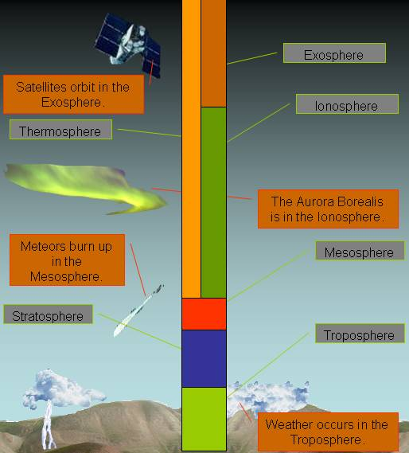
The Layers of the Atmosphere
(They’re out of this world!
Lol, get it? ☺)

Slide 22
Definitions
Atmosphere: blanket of gases surrounding Earth
Altitude: height
Temperature: NOT HEAT; measurement of how quickly or how slowly molecules move around

Slide 23
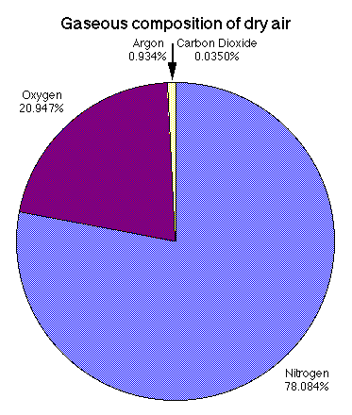
Makeup of Gases in the Atmosphere
* REMEMBER! Most of Earth’s atmosphere is not made up of oxygen. It’s mostly made of nitrogen. This is good because actually, with too much oxygen we would all die. Our insides would start to “rust!”
DRAW THIS

Slide 24
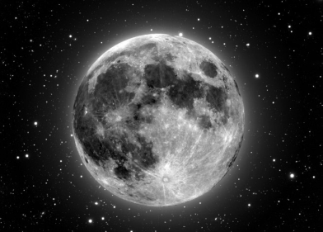
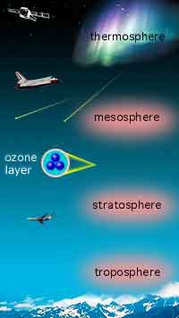
EXOSPHERE
The “5” Layers

Slide 25
For homework you made a foldable on the 5 layers of the atmosphere! As we walk through each layer, please go through and add an information you missed your foldable!

Slide 26
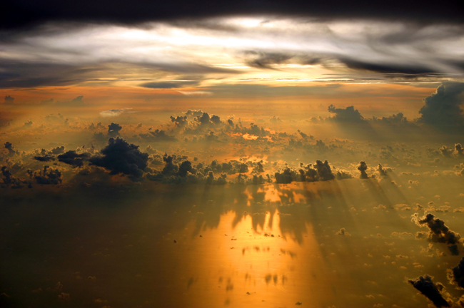
Lies next to the Earth’s surface
Densest atmospheric level (because gravity pushes down on it the most)
Almost all gases, pollution and life found here
Layer where we live
Layer where weather occurs
The Troposphere

Slide 27
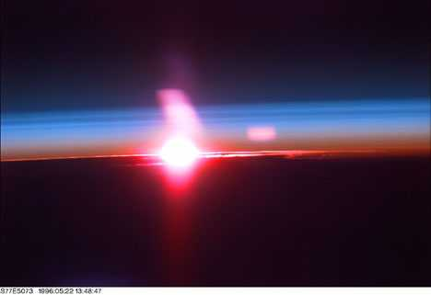
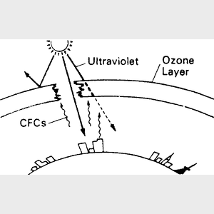
The Stratosphere
Air is very thin
There is almost no moisture in this layer so it’s very dry
* inside the stratosphere
* Contains ozone which absorbs sun rays and keeps us from overheating

Slide 28
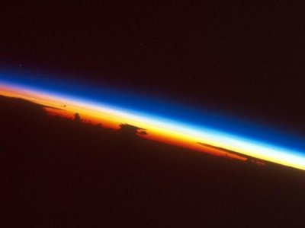
The Mesosphere
Coldest layer
As altitude increases , temperature decreases
Very windy

Slide 29
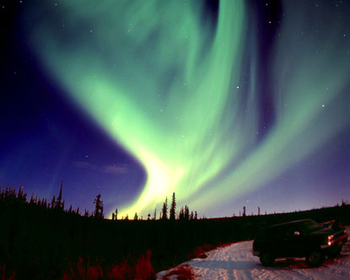
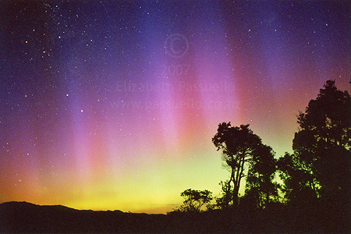
The Thermosphere
*Very high temperature (BUT IT IS NOT HOT).
*This is because the particles are moving fast but do not touch.
* Contains the ionosphere where electricity makes gases light up = The Northern and Southern Lights

Slide 30
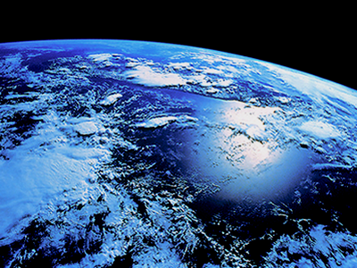
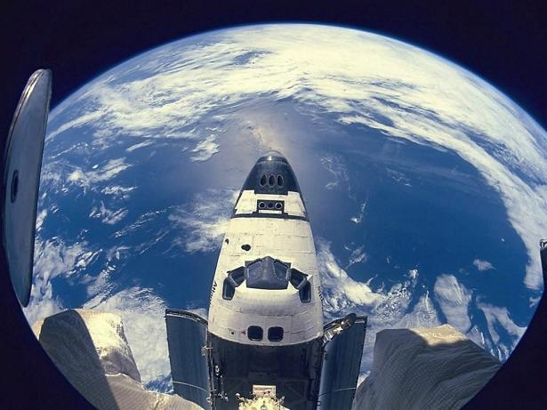
The Exosphere
This is outer space!!

Slide 31
Agenda
Warm Up & Homework Check
Scientific Method Review
Density Review
Air Pressure Notes
Layers of the Atmosphere Notes
Data Tracking & Project Intro☺

Slide 32
Data Tracking!
This year, you’ll be tracking your own growth in science!!
Tomorrow we will be doing one-on-one conferences (student & Mrs. Oates) about your progress.
We already put together our folders.

Slide 33
NOVICE:
I’m just starting to learn this, and I don’t really understand it yet.
APPRENTICE:
I’m starting to get it, but I need someone to coach me through it.
PRACTITIONER:
I can mostly do it by myself, but sometimes I mess up or get stuck.
EXPERT:
I understand it well, and could thoroughly teach it to someone else.

